Slide 1

Chapter Five
Marketing & New Venture Development

Slide 2
CHAPTER FIVE
MARKETING AND NEW VENTURE DEVELOPMENT
5.1 Market Research for the New Venture
Marketing research involves the gathering and analysis of data in order to determine such information as who will buy the product, what price should be charged, and what is the most effective promotion strategy.
5.1.1 The Marketing Research Process
  Problem/opportunity identification and formulation
  Definition of the research objectives
  Choosing a basic method of research
  Identifying the sample size and selecting the sampling procedures
  Collecting the data
  Analyzing the data
  Preparing and writing the report
  Follow up

Slide 3
5.2 Marketing Intelligence System
Marketing intelligence system is a set of procedures and sources used by managers to obtain their everyday information about pertinent development in the marketing environment.
Marketing managers often carry on marketing intelligence by reading books, newspapers, and trade publications; talking to customers, suppliers’, distributors, and other outsiders; and talking with other managers and personal within the company.
Information for marketing decision making may be broadly classified as: (i) strategic (ii) tactical (iii) Data bank.
The first type refers to information needed for strategic decisions, e g. whether to enter a specific overseas market or to diversify into new markets; the second type relates to information for tactical decisions such as planning of sales territories the third type provides essential background knowledge about, for example, competitors’ activities, market trends etc.

Slide 4
5.3 Competitive Analysis
A competitive analysis is essentially a structured method of examining an organization or industry in order to provide a clear understanding of the factors that affect a business.
Porter’s Five Forces Model
Porters model of competitive forces assumes that there are five competitive forces that identifies the competitive power in a business situation. These five competitive forces identified by the Michael Porter are:
  Threat of substitute products
  Threat of new entrants
  Intense rivalry among existing players
  Bargaining power of suppliers
  Bargaining power of Buyers

Slide 5
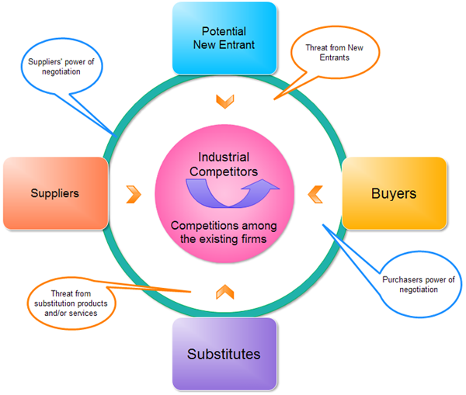

Slide 6
Threat of substitute products
Threat of substitute products means how easily your customers can switch to your competitors product. Threat of substitute is high when:
  There are many substitute products available
  Customer can easily find the product or service that you’re offering at the same or less price
  Quality of the competitors’ product is better
  Substitute product is by a company earning high profits so can reduce prices to the lowest level.
In the above mentioned situations, Customer can easily switch to substitute products. So substitutes are a threat to your company.

Slide 7
Threat of new entrants
A new entry of a competitor into your market also weakens your power. Threat of new entry depends upon entry & exit barriers. Threat of new entry is high when:
  Capital requirements to start the business are less
  Few economies of scale are in place
  Customers can easily switch (low switching cost)
  Your key technology is not hard to acquire or isn’t protected well
  Your product is not differentiated
There is variation in attractiveness of segment depending upon entry and exit barriers. That segment is more attractive which has high entry barriers and low exit barriers.

Slide 8
Industry Rivalry
Industry rivalry mean the intensity of competition among the existing competitors in the market. Intensity of rivalry depends on the number of competitors and their capabilities. Industry rivalry is high when:
  There are number of small or equal competitors and less when there’s a clear market leader.
  Customers have low switching costs
  Industry is growing
  Exit barriers are high and rivals stay and compete
  Fixed cost are high resulting huge production and reduction in prices
These situations make the reasons for advertising wars, price wars, modifications, ultimately costs increase and it is difficult to compete.

Slide 9
Bargaining power of suppliers
Bargaining Power of supplier means how strong is the position of a seller. How much your supplier have control over increasing the Price of supplies. Suppliers are more powerful when
  Suppliers are concentrated and well organized
  a few substitutes available to supplies
  Their product is most effective or unique
  Switching cost, from one suppliers to another, is high
  You are not an important customer to Supplier
When suppliers have more control over supplies and its prices that segment is less attractive. It is best way to make win-win relation with suppliers. It’s good idea to have multi-sources of supply.

Slide 10
Bargaining power of Buyers
Bargaining Power of Buyers means, How much control the buyers have to drive down your products price, Can they work together in ordering large volumes. Buyers have more bargaining power when:
  Few buyers chasing too many goods
  Buyer purchases in bulk quantities
  Product is not differentiated
  Buyer’s cost of switching to a competitors’ product is low
  Shopping cost is low
  Buyers are price sensitive
Buyer’s bargaining power may be lowered down by offering differentiated product. If you’re serving a few but huge quantity ordering buyers, then they have the power to dictate you.
Michael Porters five forces model provides useful input for SWOT Analysis and is considered as a strong tool for industry competitive analysis.

Slide 11
5.4 Marketing Strategies for Competitive Positions
Marketing strategies are those plans designed to reach marketing goals.
Types of Marketing Strategies
Strategies based on market Dominance - Typically there are four types of market dominance strategies:
    Market Leader
    Market Challenger
    Market Follower
    Market Nicher

Slide 12
1. Market Leader
The market leader is dominant in its industry. It has substantial market share and often extensive distribution arrangements with retailers. It typically is the industry leader in developing innovative new business models and new products (although not always). It sometimes has some market power in determining either price or output. Of the four dominance strategies, it has the most flexibility in crafting strategy.
Market leader strategies (main options available):
Expand the total market by finding
    New users of the product
    New uses of the product
    More usage on each use occasion
Protect your existing market share by:
    Developing new product ideas
    Improve customer service
    Improve distribution effectiveness
    Reduce costs
Expand your market share:
    by targeting one or more competitor
    without being noticed by government regulators

Slide 13
2. Market Challenger
A market challenger is a firm in a strong, but not dominant position that is following an aggressive strategy of trying to gain market share. It typically targets the industry leader (for example, Pepsi targets Coke), but it could also target smaller, more vulnerable competitors.
Some of the options open to a market challenger are:
  Price discounts or price cutting
  Line extensions
  Introduce new products
  Increase product quality
  Improve service
  Change distribution
  Cost reductions
  Intensify promotional activity

Slide 14
3. Market Follower
A market follower is a firm in a strong, but not dominant position that is content to stay at that position.
The advantages of this strategy are:
  No expensive R&D failures
  No risk of bad business model
  Best practices? are already established
  Able to capitalize on the promotional activities of the market leader
  Minimal risk of competitive attacks
  Don’t waste money in a head-on battle with the market leader

Slide 15
4. Market Nicher
In this niche strategy the firm concentrates on a selected few target markets. It is also called a focus strategy. It is hoped that by focusing ones marketing efforts on one or two narrow market segments and tailoring your marketing mix to these specialized markets, you can better meet the needs of that target market.
The niche should be large enough to be profitable, but small enough to be ignored by the major industry players.
Profit margins are emphasized rather than market share. The firm typically looks to gain a competitive advantage through effectiveness rather than efficiency. It is most suitable for relatively small firms and has much in common with.

Slide 16
The most successful nichers tend to have the following characteristics:
  They tend to be in high value added industries and are able to obtain high margins.
  They tend to be highly focused on a specific market segment.
  They tend to market high end products or services, and are able to use a premium pricing strategy.
  They tend to keep their operating expenses down by spending less on R&D, advertising, and personal selling.
2. COST LEADERSHIP STRATEGY
This strategy emphasizes efficiency. By producing high volumes of standardized products, the firm hopes to take advantage of economies of scale.
Maintaining this strategy requires a continuous search for cost reductions in all aspects of the business.
To be successful, this strategy usually requires a considerable market share advantage or preferential access to raw materials, components, labor, or some other important input.

Slide 17
Successful implementation also benefits from:
  Process engineering skills
  Products designed for ease of manufacture
  Sustained access to inexpensive capital
  Close supervision of labor
  Tight cost control
  Incentives based on quantitative targets
3. DIFFERENTIATION STRATEGY
Differentiation involves creating a product that is perceived as unique.
The unique features or benefits should provide superior value for the customer if this strategy is to be successful.
Customers tend to be more brand loyal.

Slide 18
To maintain this strategy the firm should have:
    Strong research and development skills
    Strong product engineering skills
    Strong creativity skills
    Good cooperation with distribution channels
    Strong marketing skills
    Incentives based largely on subjective measures
    Be able to communicate the importance of the differentiating product characteristics
    Stress continuous improvement and innovation
    Attract highly skilled, creative people

